Slide 1
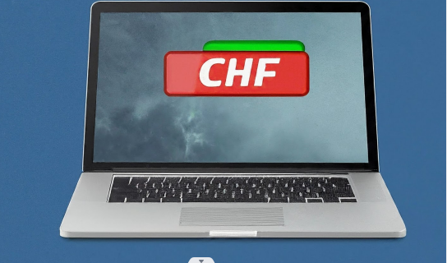
Free Up Your C Drive in 5 Easy Steps
Hi everyone, today we'll walk through a simple process to clone your contacts from your C drive to your D drive on your HP laptop. This will help free up space on your C drive and keep your contacts safe on your D drive.

Slide 2
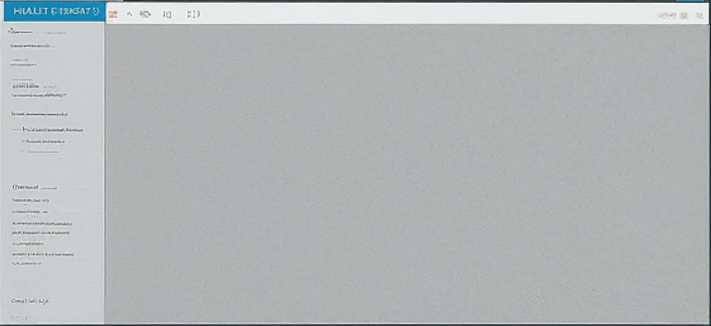
Identifying Contact Location.
Open "File Explorer" (Windows Key + E)
Click on your Username on the left panel (e.g., Documents, Pictures)
Locate the "Contacts" folder.

Slide 3
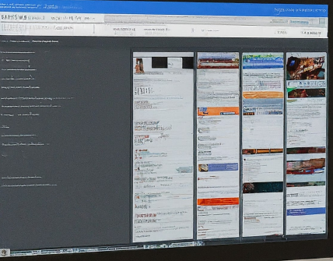
Copying Contacts
Right-click on the "Contacts" folder
Select "Cut"
Once we've identified the "Contacts" folder, we'll proceed to copy it. Here, we'll use the "Cut" function to ensure the folder is removed from its original location after copying.

Slide 4
Pasting to Local Disk D
Navigate to Local Disk D (usually labeled "D:") in the left panel
Right-click on any empty space within Local Disk D
Select "Paste"

Slide 5
Confirmation and Verification
Open Local Disk D (D:)
Verify that the "Contacts" folder is successfully pasted
(Optional) Open your contacts application and confirm your contacts are present
By highlighting these built-in tools (Windows Key + E shortcut, File Explorer context menu options - Cut, Paste), your friend will understand they don't need any additional software to clone their contacts. This keeps the process simple and leverages the features already available on their HP laptop.

